Slide 1

Customer Shopping Behavior Analysis
Analyzing 3,900 real purchase transactions to understand spending patterns, product preferences, discount influence, and subscription impact for smarter business strategies.

Slide 2
Dataset Overview
Scale
Customer Data
3,900 transactions across 18 data columns
Age, gender, location, subscription status
Purchase Details
Behavioral Metrics
Category, amount, season, discount usage, shipping type
Previous purchases, frequency, review ratings
Comprehensive dataset capturing customer demographics, purchase information, shopping behavior, and product reviews to enable data-driven decision making.

Slide 3


Data Preparation Process
01
02
03
Data Loading
Quality Checks
Data Cleaning
Imported dataset using pandas and performed initial structure review
Identified 37 missing review ratings and assessed data consistency
Filled missing values with category-specific median ratings
04
05
Feature Engineering
Database Integration
Created age groups and purchase frequency metrics
Loaded cleaned data into PostgreSQL for advanced analysis

Slide 4
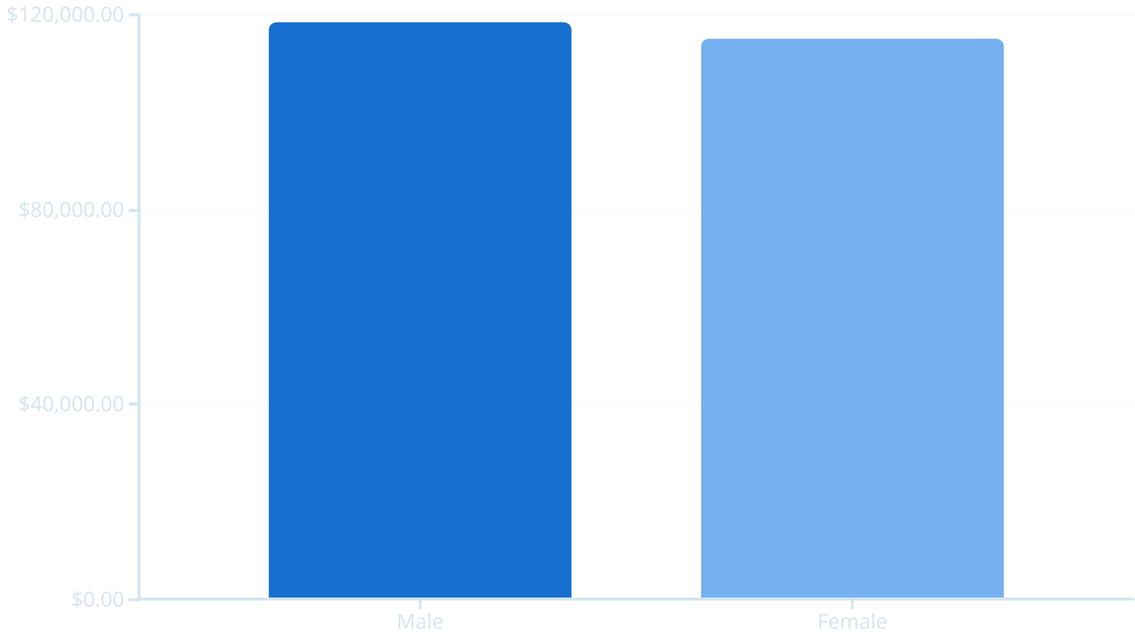
Revenue Analysis by Gender
Key Finding
Male and female shoppers contribute nearly equal revenue, with male customers generating slightly higher total sales.
This balanced distribution suggests marketing strategies should maintain equal focus across both demographics.

Slide 5

Subscription Impact on Revenue
$62
$58
7%
Subscribers
Non-Subscribers
Premium
Average purchase amount
Average purchase amount
Higher spending by subscribers
Subscribers demonstrate higher average spending and generate significantly more total revenue, validating the importance of subscription programs in driving business growth.

Slide 6



Top Performing Products
1
2
3
Blouse
Jewelry
Dress
Highest customer rating: 5.0 stars
Premium rating: 5.0 stars
Excellent rating: 5.0 stars
4
5
Handbag
Sunglasses
Strong rating: 4.9 stars
High rating: 4.8 stars
These top-rated products represent significant opportunities for featured marketing campaigns and inventory prioritization.

Slide 7


Customer Segmentation Analysis
New
Returning
Loyal
New Customers (32%)
Returning Customers (41%)
Loyal Customers (27%)
First-time buyers requiring onboarding and engagement strategies
Repeat purchasers showing positive brand affinity
High-value segment with strong purchase history

Slide 8
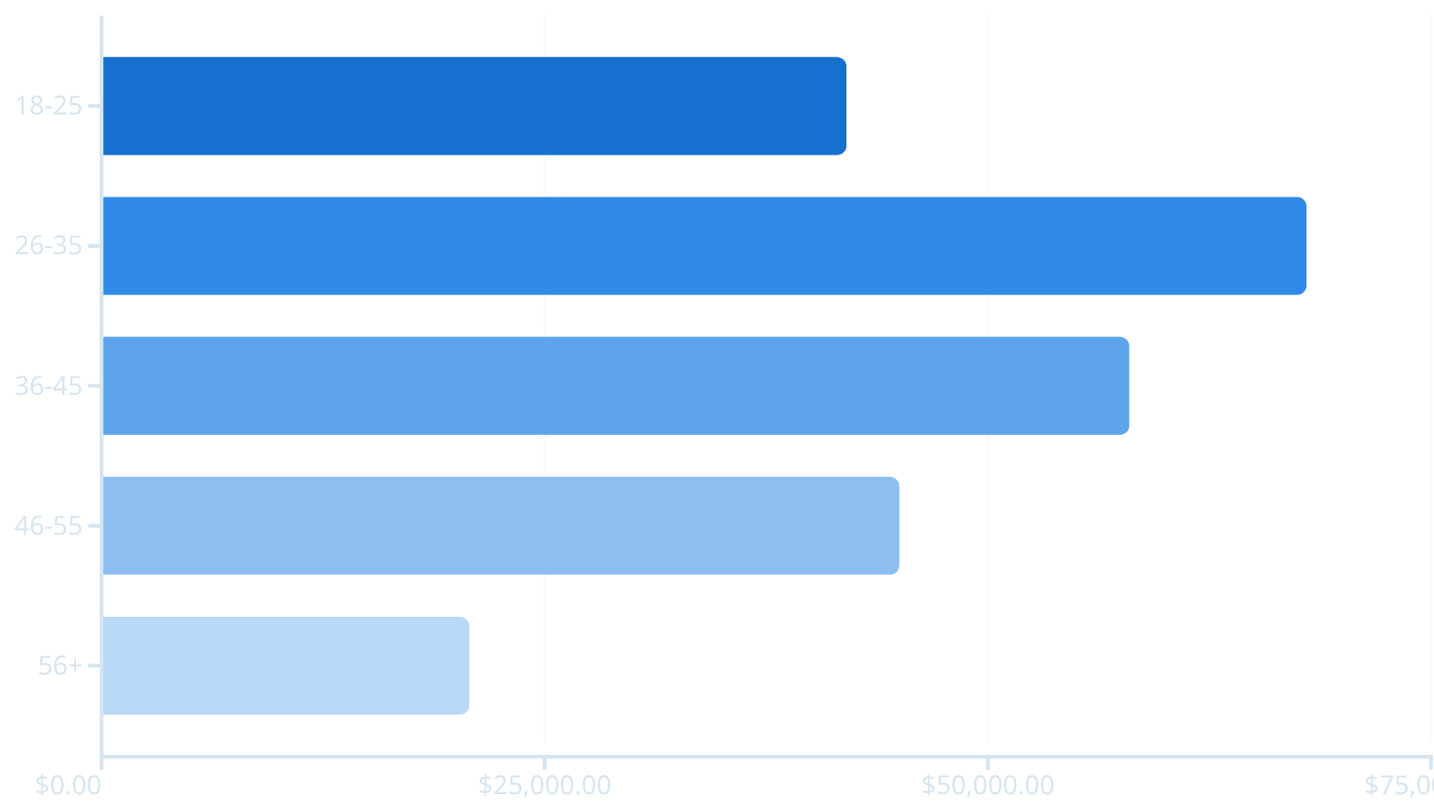
Revenue Distribution by Age Group
Strategic Insight
The 26-35 age group drives the highest revenue, representing the core target demographic.
Marketing investments should prioritize this segment while developing growth strategies for adjacent age groups.

Slide 9
Shipping & Discount Insights
Express Shipping
Standard Shipping
Average purchase: $61
Average purchase: $59
Higher-value transactions correlate with expedited delivery preferences
Slight difference suggests shipping speed is not a primary purchase driver
Discount Usage
Product Dependency
High spenders still use discounts
Certain items rely heavily on discounts
Customers spending above average frequently apply promotional codes
Requires strategic pricing review to maintain margins

Slide 10






Strategic Recommendations
Boost Subscriptions
Strengthen Loyalty
Optimize Discounts
Offer exclusive perks and personalized incentives to drive subscription adoption
Reward repeat buyers with points, special offers, and early product access
Balance promotional strategy to maintain profitability without reducing volume
Targeted Marketing
Product Positioning
Focus campaigns on high-revenue age groups and express shipping customers
Highlight top-rated and bestselling items in all marketing initiatives

